Slide 1
Introduction to Cloud Foundry

Slide 2
Unit Objections
Cloud Foundry Overview
Buildpacks
Diego Components
Diego Architecture
Application Staging
BOSH

Slide 3
Cloud Foundry – Why?
Client Need | An open source PaaS that lets an organization quickly create and deploy applications on the cloud
Use Case | New applications & App modernization Work load flexibility and scalable sizing Development Hybrid - expanding into cloud while maintaining close ties to existing systems
Why Cloud Foundry | Fast application development and deployment Highly scalable and available architecture DevOps-friendly workflows - Reduced chance of human error Multi-tenant compute efficiencies
Differentiators | Embracing 3rd-party services API Ecosystem and Management Services leveraging the depth of IBM software Integrate with your on-premises applications

Slide 4
Cloud Foundry – Advantages
Cloud Foundry Offers | A suitable environment to run an application Integration with development tools Full application deployment Application lifecycle management Integration with various cloud providers Application execution Self-healing capacity Centralized management of applications Distributed environment Easy integration Easy maintenance (upgrades, etc.)

Slide 5
Cloud Foundry Buildpack
Like Kubernetes, Cloud Foundry uses containers for the runtime executable
Unlike Kubernetes, Cloud Foundry builds the images used to create the containers
Kubernetes isn’t responsible for building the images and doesn’t care where they come from
This makes CF what is called an "opinionated" platform, one that not only runs containers but builds the images as well
Cloud Foundry uses buildpacks to create the images
You provide CF your application code, everything else is provided by the platform.
Cloud Foundry is smart enough to pick the buildpack that matches your code language. You have the ability to specify the buildpack to use
The buildpack provides framework and runtime support for your app
The buildpack will determine what dependencies to download and how to configure your app
The buildpack is used to compile or prepare your app for launch

Slide 6
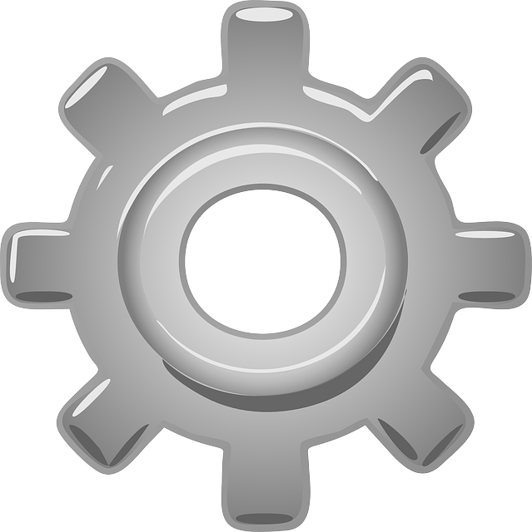
Buildpack in summary
App
App and dependencies
Runtime binaries
Runtime configurations
Droplet
Buildpack
Metadata
Language Runtime Binaries Repository
Notes:
CF uses containers to separate Build from Run. This is accomplished in two stages, shown in this slide and the next one.
A CF buildpack builds a Droplet, which is essentially the container image that contains the app, its configuration, and its runtime--but without the OS (which the runtime will require to run).

Slide 7
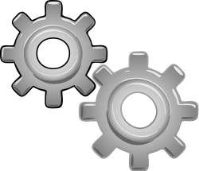
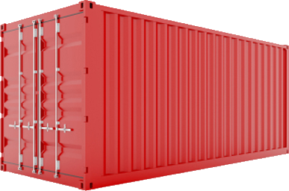
Cloud Foundry runtime in summary
Droplet
Metadata
Container
Diego Engine
Image (preinstalled)
Notes:
The CF DEA then combines the Droplet image with an OS image to produce a Warden container, which is a fully executable runtime. The container is immutable, so it’s stateless (or won’t maintain state).
This is the patterns Containerization and Container per Service.
Once the image is built and released, it cannot be changed. (New pushes of the same app build new images that replace the old one(s).) Thus new instances (containers) can be created (such as for elasticity) that are exactly like the old ones that have already been deployed. This is much better than recompiling the code and reinstalling the runtime each time, which might not result in a new instance that is exactly like the old instance. Thus Build and Release is only done once, then Run is done whenever needed.

Slide 8
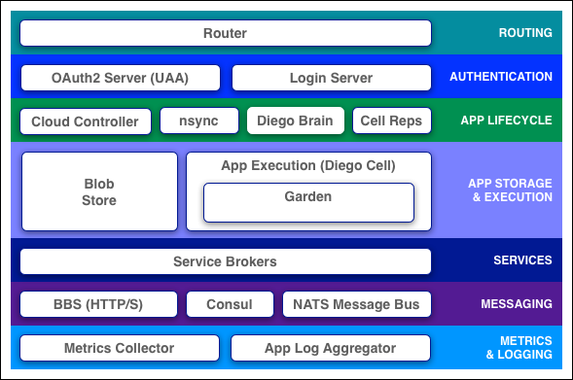
Diego components
Cloud Foundry PaaS
Cloud Foundry services registry and runtime management layer
Components are dynamically discoverable and loosely coupled
Expose health through HTTP endpoints so agents can collect state and act on it

Slide 9
Cloud Foundry Components: Router
Router
Shapes and routes all external system traffic (HTTP/API) and application traffic from the internet/intranet
Maintains a dynamic routing table for each load-balanced app instance with IP addresses and ports for access via the internet
Maps an app’s route to the IP:port of each of the app’s containers

Slide 10
Cloud Foundry Components: Cell and Garden
Diego Cell
Each Cell runs as a VM
Garden containers run in Cells
Manage application lifecycle
Stage & run
Droplets are built in Cells
Built by buildpacks
Garden
Each Garden instance is a Linux container
Each application instance runs in a Garden container
Provides a simple API for managing isolated environments

Slide 11
Cloud Foundry Components: Cloud Controller
Cloud Controller
Interface for clients to talk to Cloud Foundry
CF CLI
Eclipse
Bluemix Dashboard
RESTful interface to Cloud Foundry domain objects
Applications
Services
Organizations
Spaces
Service instances
User roles
Etc.

Slide 12
Cloud Foundry Components: Diego Brain
Auctioneer: Placement
Assigns Tasks and LRPs to Cells
Converger: Health management
Monitors application health
Actual vs. expected
Cells provide the current state
Database provides the expected state
If the Converger sees an incorrect current state, it notifies the Auctioneer

Slide 13
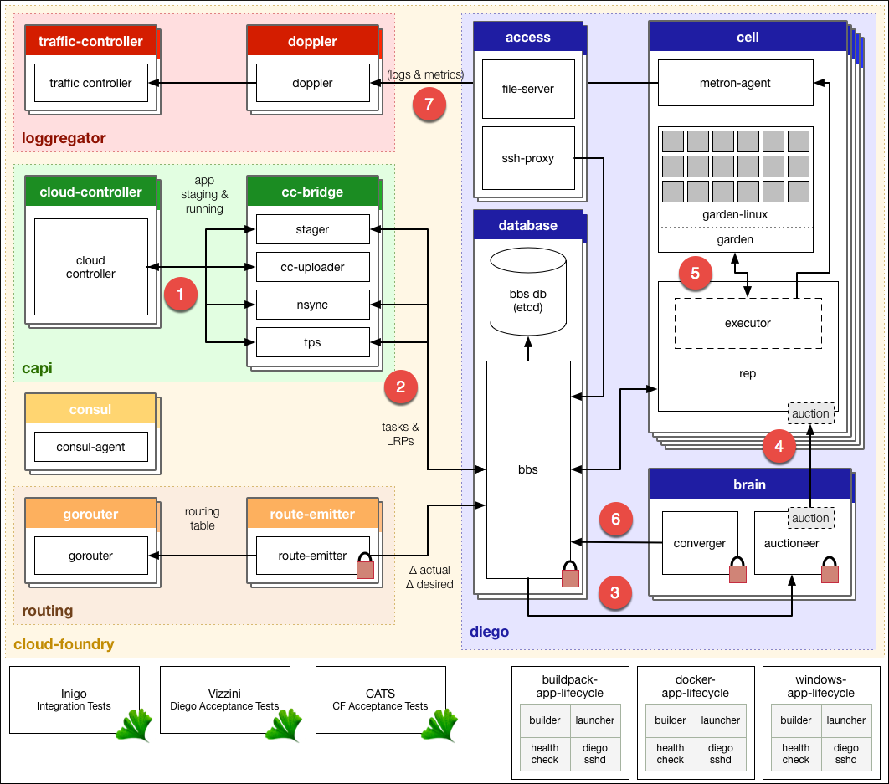
Diego architecture
How Diego handles application requests
Requests to stage and run applications
Schedule Tasks and LRPs
Submit Tasks and LRPs to Auctioneer
Distribute Tasks and LRPs to Cells
Run Task or LRP in Garden container
Converger corrects LRP discrepancies
Metron Agent forwards logs and metrics

Slide 14
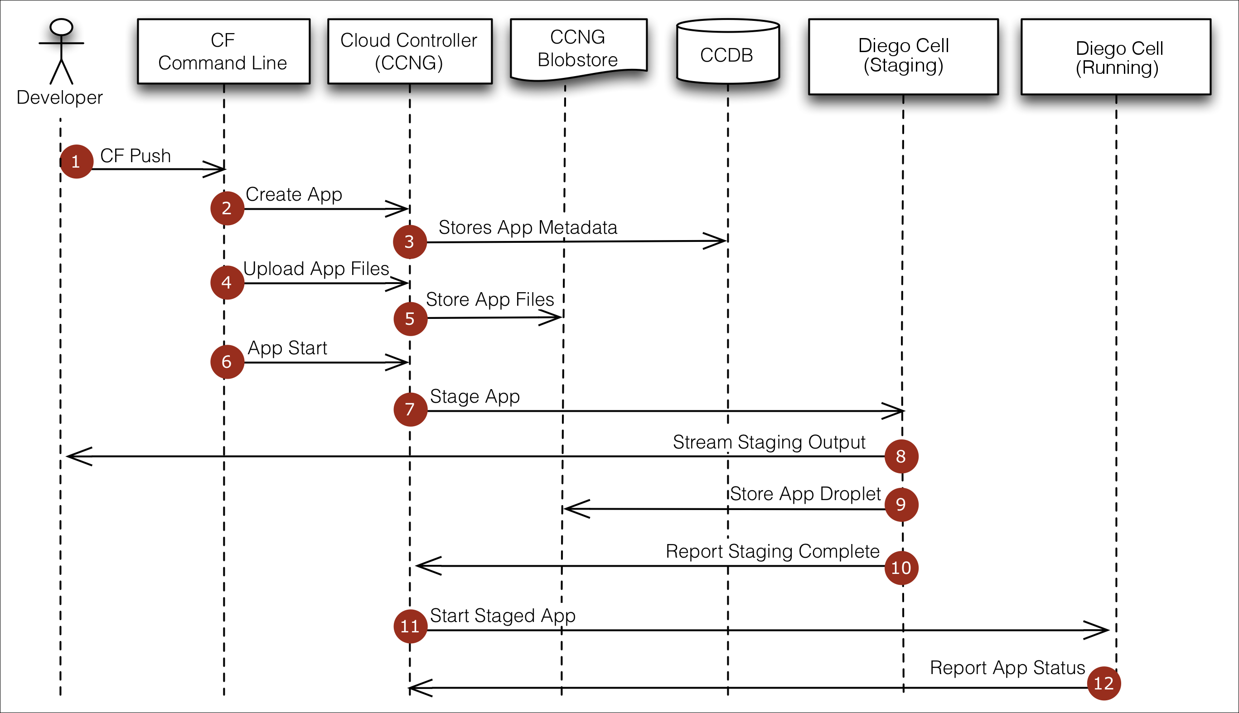
Application Staging

Slide 15
IBM Cloud Private with Cloud Foundry
Evolution of the Cloud Foundry Runtime
BOSH installs CloudFoundry on an IaaS platform (i.e. vCloud)
BOSH uses CPI (Cloud Platform Interface) to interact with the IaaS provider
Release
Name
Software packages
Config templates
Scripts
Deployment manifest
Release name / version
# of VMs
Job params
Stemcells to use
Stemcell (VM image)
Base OS
BOSH agent
BOSH
CPI
IaaS platform
VM
VM
VM
VM

Slide 16
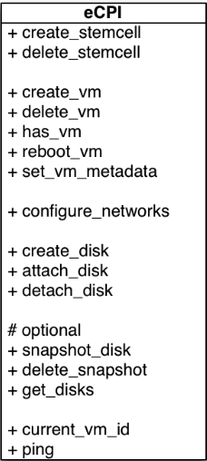
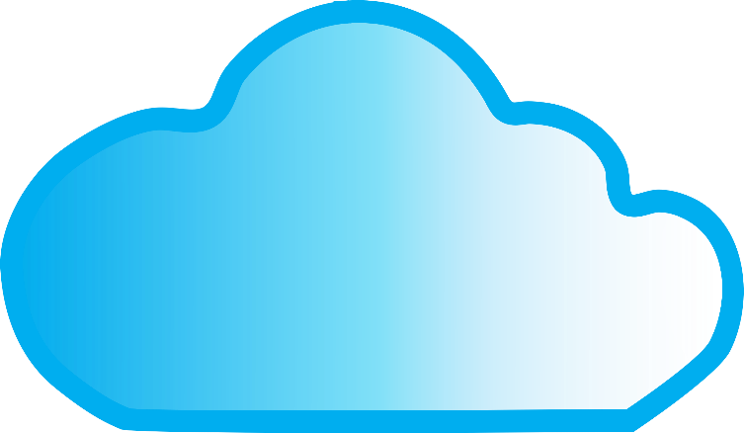
CPI (Cloud Platform Interface) API
IaaS platform
BOSH director

Slide 17
Unit Summary
Cloud Foundry Overview
Buildpacks
Diego Components
Diego Architecture
Application Staging
BOSH

